Slide 1
Story Board for CEC Student Maps
CSCE 190
Assignment Name: Storyboard
Group Name: CEC Student Maps
Team Members who contributed:
First Name | Last Name | Email
Ty | Bettis | tbettis@email.sc.edu
Jay | Cunningham | jamyius@email.sc.edu
Quintarius | Floyd | qfloyd@email.sc.edu
Jacob | Vaught | jvaught@sc.edu

Slide 2
Jacob Vaught
Mr. Hendrick

Slide 3

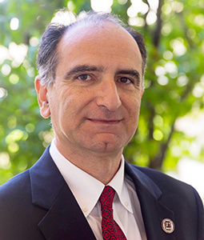
Mr. Hendrick has an important meeting with the dean of the Engineering college at 2PM to discuss philanthropic opportunities.

Slide 4
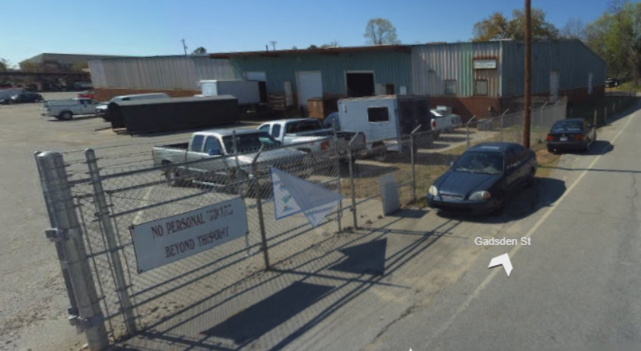
Unfortunately, Mr. Hendrick is running behind due to a previous meeting with Clemson running over. Also, The Dean decided to meet in the “Surplus”, and No one knows where it is.

Slide 5
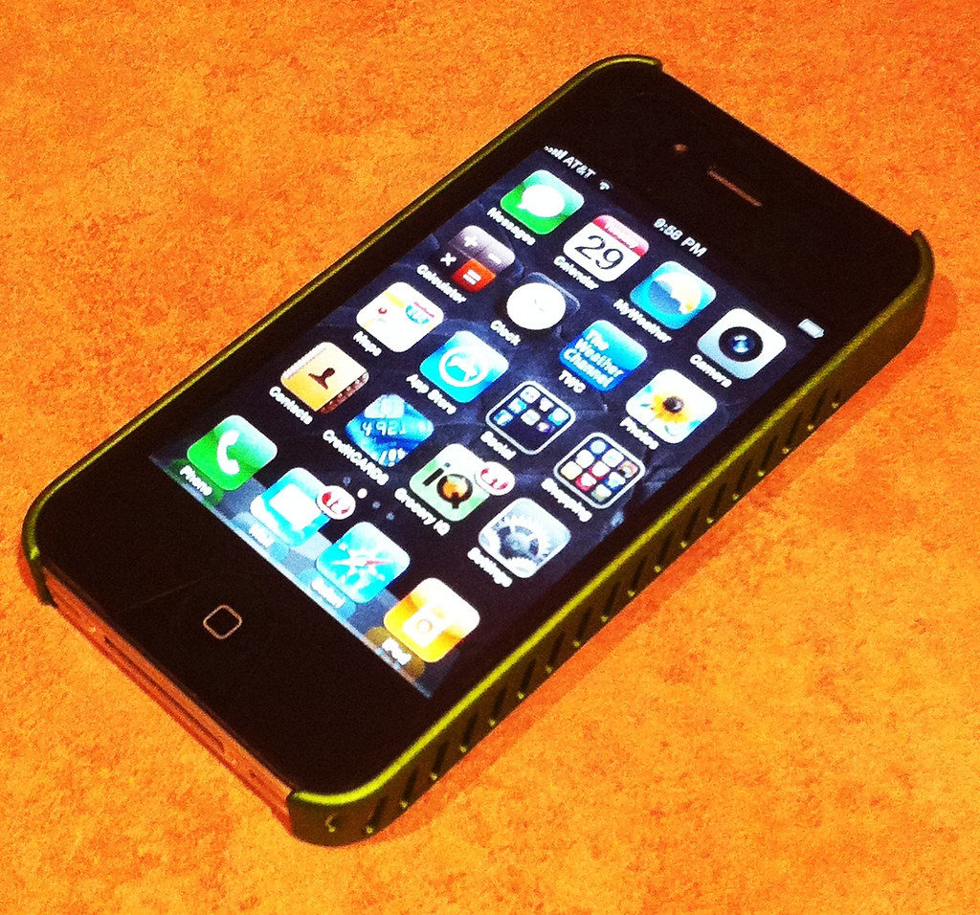
He goes on google, but due to the building being older, it has not been added to Google Maps. He tries to call the dean but can’t contact him.
This Photo by Unknown Author is licensed under CC BY

Slide 6
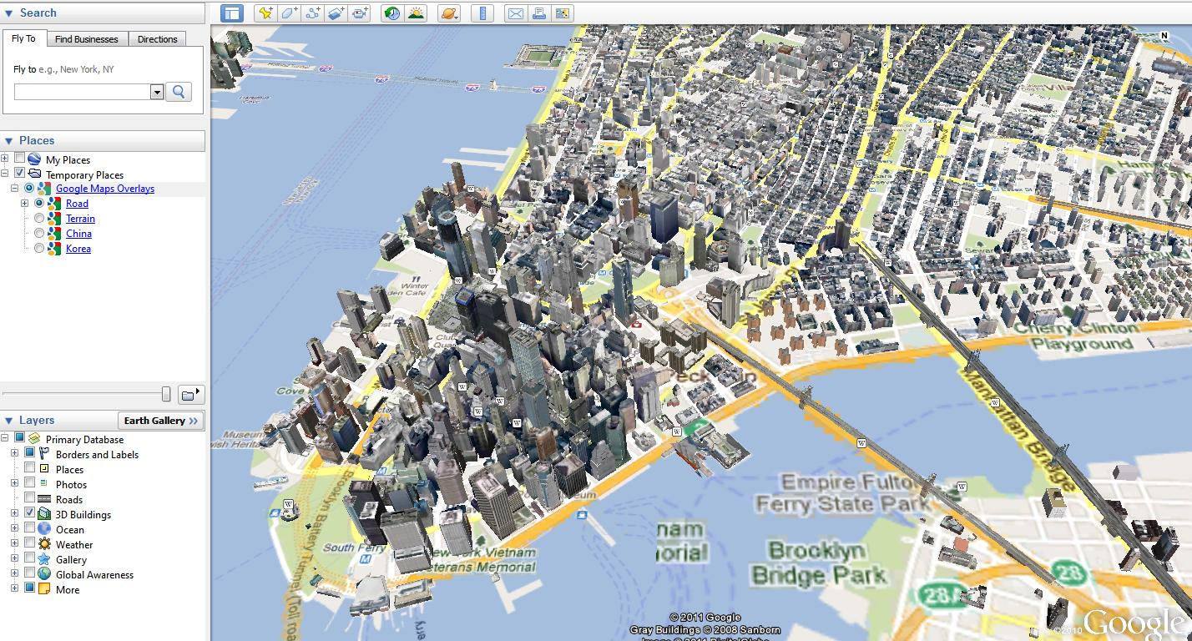
Then He remembers a recent Senior Design Project For Computer Science students. A navigational app for the University. He types the name into the app and gets AR Directions immediately.
This Photo by Unknown Author is licensed under CC BY-SA

Slide 7
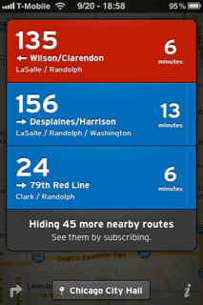
He utilizes the location sharing feature in the app to share his location with the dean and utilizes the bus-tracking features to catch the closest bus to get to the warehouse as soon as possible
This Photo by Unknown Author is licensed under CC BY-SA-NC

Slide 8
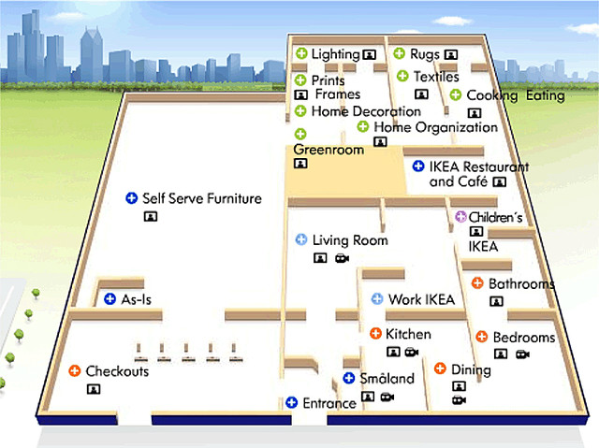
When he gets to the warehouse, he realizes that there are multiple buildings and needs to go to the correct one. The app has contextual awareness and reads all his emails and when he goes to search, it pushes the correct building to the top of the list.
This Photo by Unknown Author is licensed under CC BY-NC-ND

Slide 9
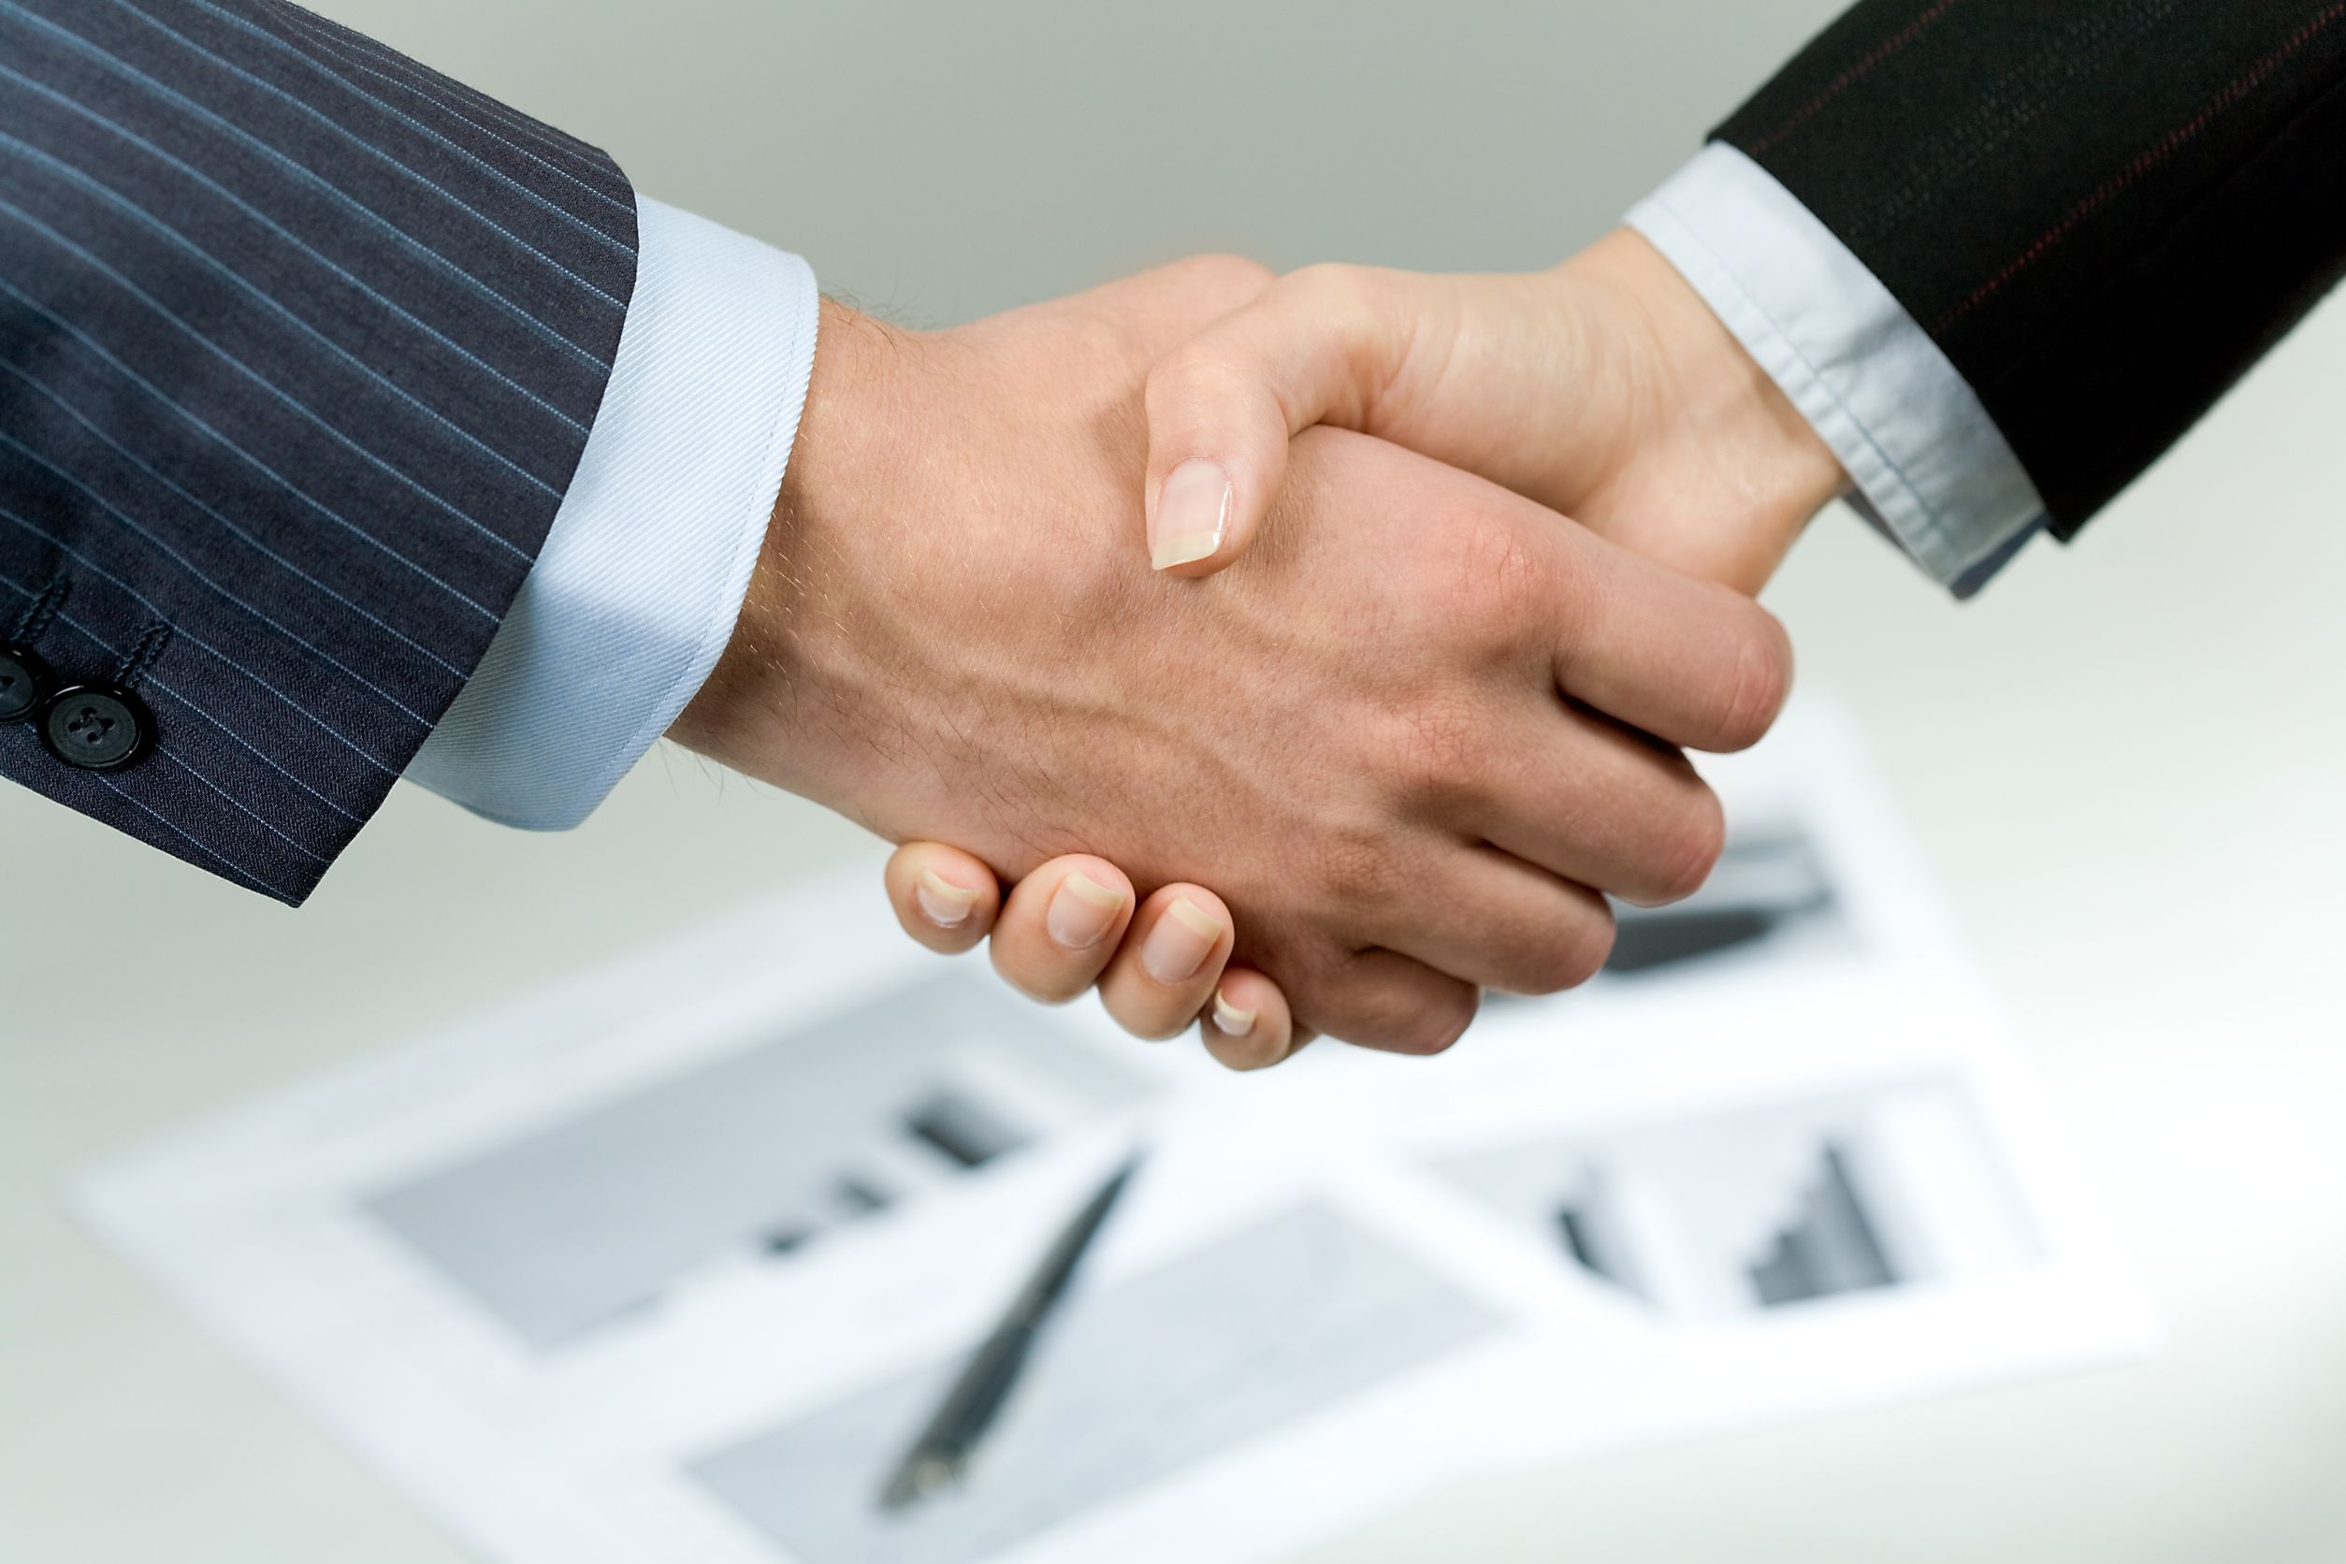
Thanks to the App, his meeting is saved, and negotiates a better deal than Clemson!
This Photo by Unknown Author is licensed under CC BY-NC

Slide 10
Emily
Produced and Written by Ty Bettis

Slide 11


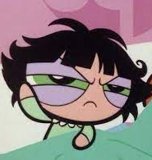

Emily has just finished a stressful shift at her cashier job and has her first nursing exam, later on in the evening , that she cannot be late to.
z

Slide 12

This is her first time having an exam right after work and she is hoping she can make it to class in time.
z

Slide 13

She uses an outdated gps that doesn’t give her alternative routes, traffic updates, and the location of where the building is she is looking for.
z

Slide 14

As she is driving to class, she has to pick up her two best friends that are taking the same exam.She notices that a train has traffic backed up on Huger st and begins to panic because the exam starts in 10 minutes
z

Slide 15
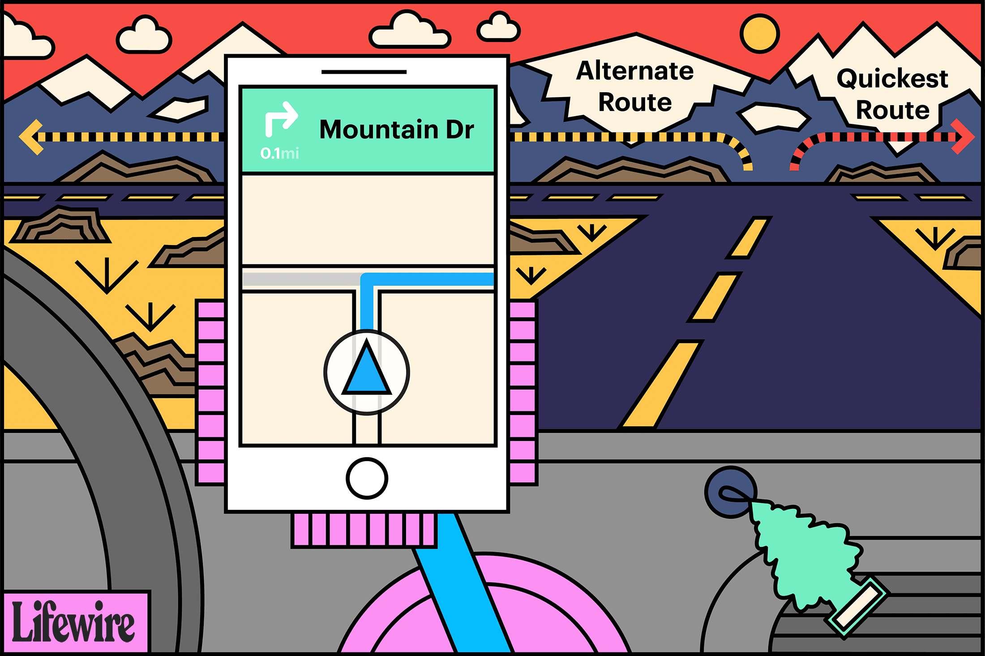
Her friend, Amanda tells her to not panic and pulled up her app called “CEC student maps” that allows you to see a map of USC campus, alternative faster routes to a specific building, and buildings you are allowed in.
z

Slide 16

Thanks to the app, Emily and her friends were able to find an alternative route to go around the train and make it to class in time for their exam.
z

Slide 17
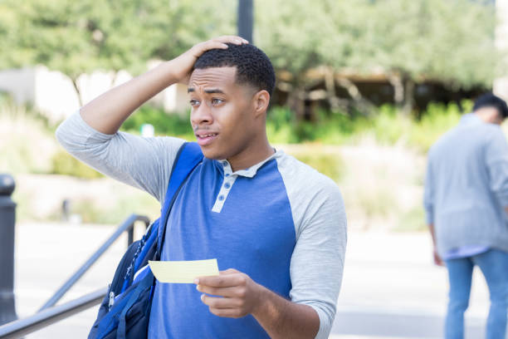
Jay Cunningham
Mike is freshman at the UofSC, today is his first day of classes and other than the campus tour he’s been on. He isn’t really familiar with the campus he is worried he is gonna be late to class on the first day because he doesn't know where the right building is.

Slide 18
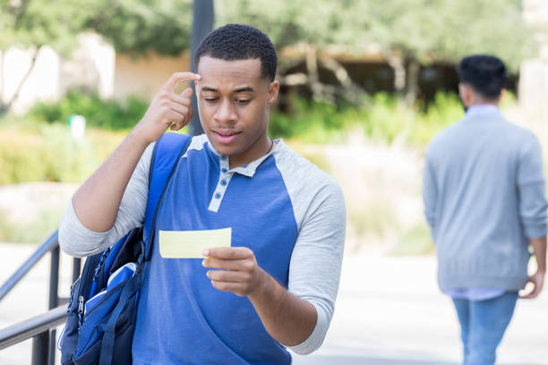
After trying to figure out where the building is wasting another five minutes, he decides that he is not going to be able to find the building on his own and decides he going to try and find another student to help him.

Slide 19
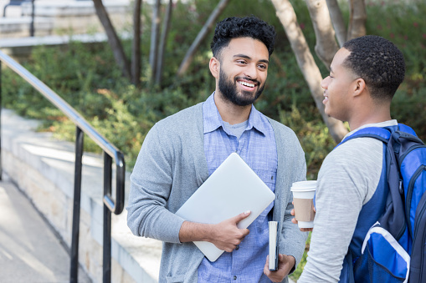
Mikey approaches a fellow student to help find the building his class is in. The student points Mikey in the direction of the building he’s looking for but also refers him to the UofSC campus app that helped him get around campus when he was a freshman.

Slide 20

Mikey had to get to get to class because he was running late but after class was dismissed he sat on a bench and downloaded the UofSC campus app to see what it was all about.

Slide 21

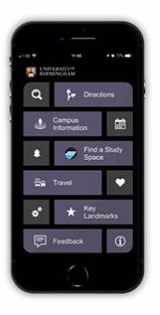
Mikey downloaded the app and was so happy after he looked at all the features, the app offered temporary carolina card access, fastest routes to all of Mikey’s classes, and finding professors offices.

Slide 22
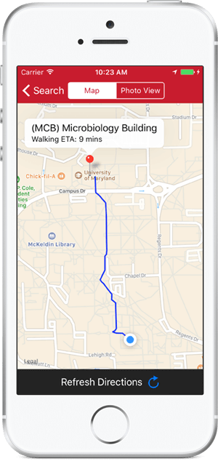
The next morning Mikey started using the UofSC campus app and had no problem getting around campus with the help of the app.

Slide 23
The Story of Logan Dahmer
By Quintarius Floyd

Slide 24
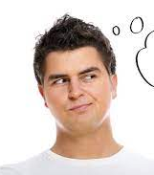
One day, Logan Dahmer said he would never party again until he got his grades up, but later that day he said one night wouldn't hurt.

Slide 25
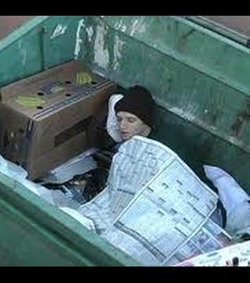
That night he partied so hard he blacked out on the other side of Columbia. He woke up in a dumpster and the worst thing was that he forgot he had class at 10 am. And he only had 30 minutes to arrive and if he was late the teacher would lower his grade level.

Slide 26
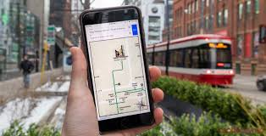
So, he whipped out is trusty guide app CSC Student Maps to help him arrive on time and it said it would take him 45 minutes to get there. He tighten up his shoe and bolted to class.

Slide 27
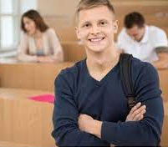
Surprisingly, he made it to class 5 minutes early. He was so happy because if he didn’t make it, he would be falling the class.

